Slide 1
Digit Recognition Using CONVOLUTIONAL NEURAL NETWORK
Zian MD Afique Amin - 1631005
Khan Nasik Sami - 1638153
Md Sariful Islam - 1626667
Abderrahmane El Massaoudi -1919859
Suhib Ahmad Abdulla -1423183

Slide 2
Introduction
Digit recognition system is the working of a machine to train itself or recognizing the digits from different sources
Problem Background:
The handwritten digits are not always of the same size, width, orientation and justified to margins as they differ from writing of person to person, so the general problem would be while classifying the digits due to the similarity between digits such as 1 and 7, 5 and 6, 3 and 8, 2 and 5, 2 and 7, etc. This problem is faced more when many people write a single digit with a variety of different handwritings.

Slide 3
Objectives
understood the datasets properly and analysis the data
the suitable algorithm (CNN) for the dataset and the problem.
developed an algorithm utilizing Convolutional Neural Network (CNN) to extract significant features from the dataset.
analyze the results obtained by the algorithm based on the developed model

Slide 4
Expected output
we will come out with a flattened matrix that will be used as an input and we will train those inputs to recognize the expected digit. So, after the project Digit recognition system, it will act as a machine to train itself or recognizing the digits from different sources like emails, bank cheque, papers, images, etc.

Slide 5
Algorithm(CNN)
The main reason behind CNN is feature engineering is not required. Before CNN, we need to spend so much time on feature selection (algorithm for features extraction). When we compare handcrafted features with CNN, CNN performance well and it gives better accuracy. It is covering local and global features. It also learns different features from images.
In algorithm based image classification, we need to select the features (local, global) and classifiers. In some cases, global features worked well and in some cases the local features worked well.

Slide 6
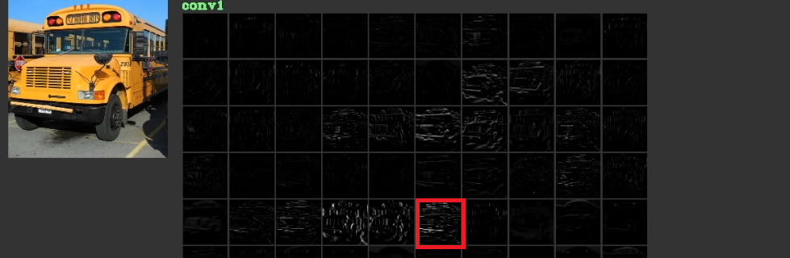
Why CNN
Learned Features in Different Layers
Capability to Handle Different Transformations to Generalize

Slide 7
Convolutional layer

Slide 8
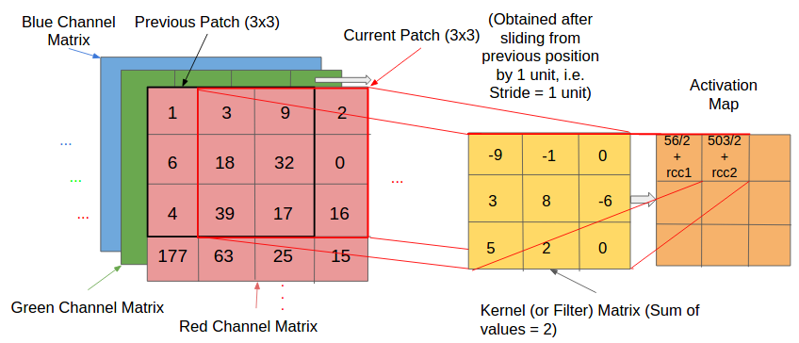

Slide 9

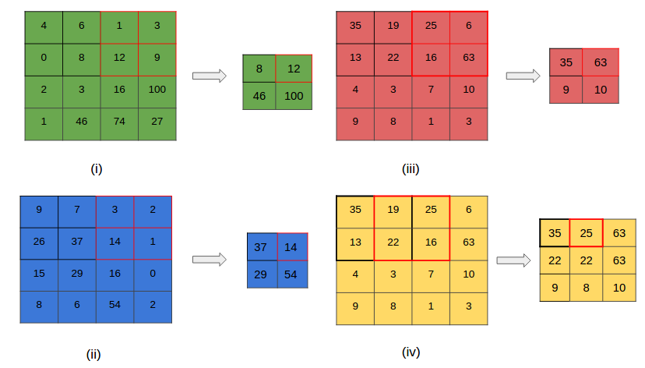
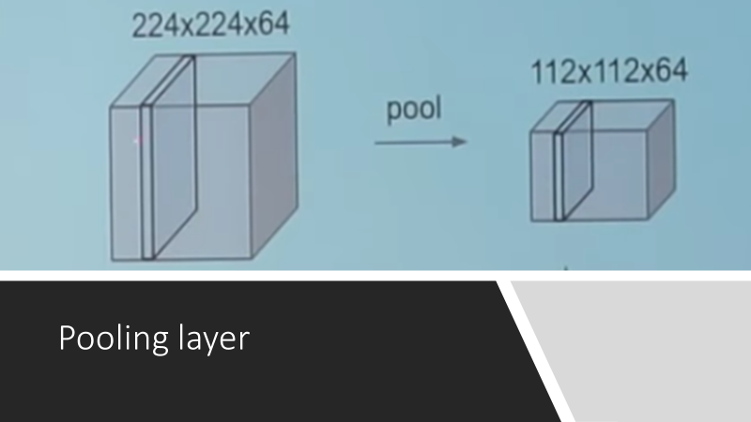
Pooling layer

Slide 10
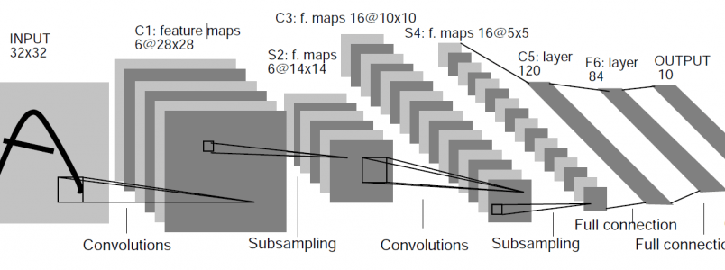
Fully-Connected Layer

Slide 11
Dataset
This dataset is a digit recognition dataset originating from the digit recognizer .The data files train.csv and test.csv contain gray-scale images of hand-drawn digits, from zero through nine.
Our data is originally from the kaggle, but it has already been processed by the author.
Thus, the training data set, (train.csv), has 785 columns.

Slide 12
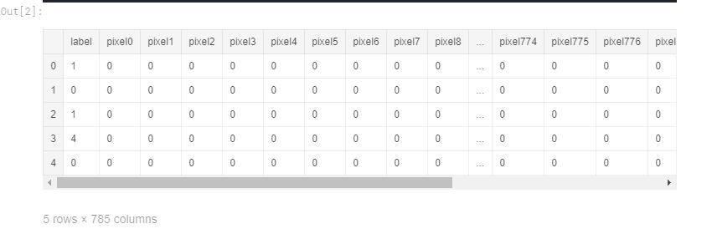
Dataset

Slide 13
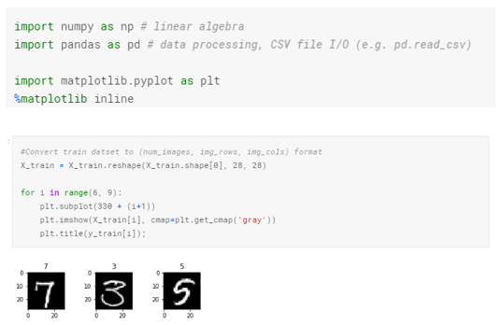
Data Visualization

Slide 14
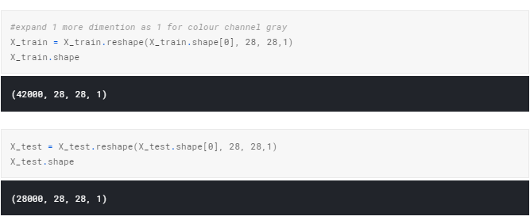
Taking the train and test data

Slide 15
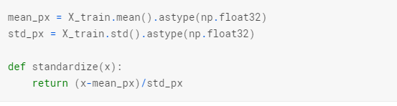
Feature Standardization
It is an important preprocessing step. It is used to center the data around zero mean and unit variance.

Slide 16
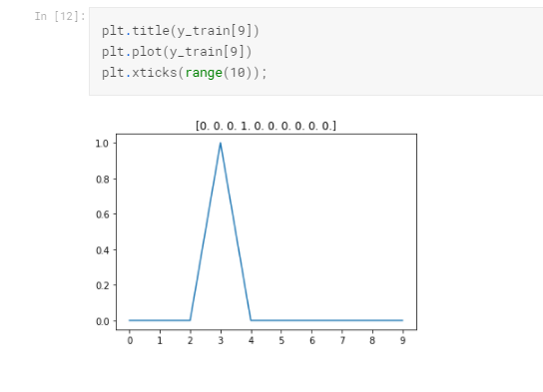

Slide 17
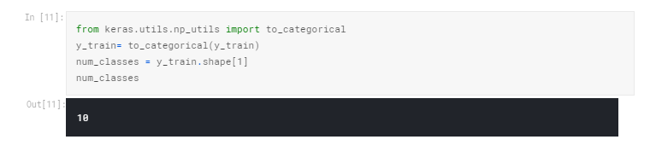
One Hot encoding of labels.
A one-hot vector is a vector which is 0 in most dimensions, and 1 in a single dimension. In this case, the nth digit will be represented as a vector which is 1 in the nth dimension.
For example, 3 would be [0,0,0,1,0,0,0,0,0,0].

Slide 18
Feature Standardization
It is an important preprocessing step. It is used to center the data around zero mean and unit variance.

Slide 19
One Hot encoding of labels.
A one-hot vector is a vector which is 0 in most dimensions, and 1 in a single dimension. In this case, the nth digit will be represented as a vector which is 1 in the nth dimension.
For example, 3 would be [0,0,0,1,0,0,0,0,0,0].

Slide 20
Finally, the output variable is an integer from 0 to 9. This is a multi-class classification problem. As such, it is good practice to use a one hot encoding of the class values, transforming the vector of class integers into a binary matrix.

Slide 21
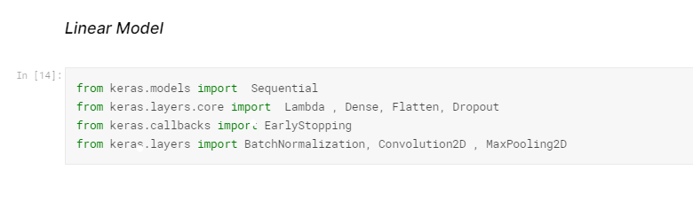
Designing Neural Network Architecture
Lambda layer performs simple arithmetic operations like sum, average, exponentiation etc.
In 1st layer of the model we have to define input dimensions of our data in (rows,columns,colour channel) format.
Flatten will transform input matrix into 1D array or vector and compile all nodes into one vector
Dense is fully connected layer that means all neurons in previous layers will be connected to all neurons in fully connected layer. In the last layer we have to specify output dimensions/classes of the model. Here it's 10, since we have to output 10 different digit labels.

Slide 22
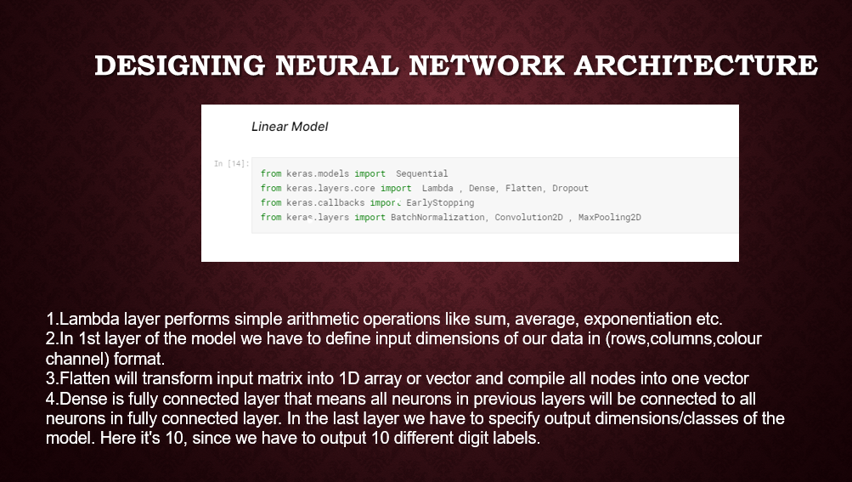

Slide 23
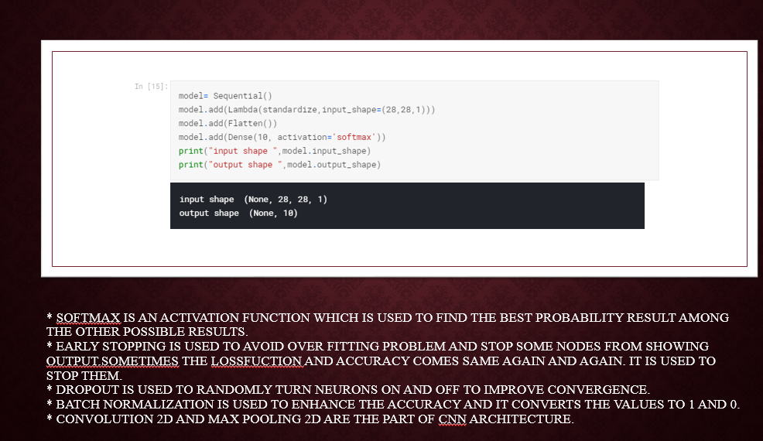

Slide 24
Compiling Network
Before making network ready for training we have to make sure to add below things:
A loss function: to measure how good the network is
An optimizer: to update network as it sees more data and reduce loss value
Metrics: to monitor performance of network

Slide 25
Cross Validation
Cross-validation, it's a model validation techniques for assessing how the results of a statistical analysis (model) will generalize to an independent data set.
It is mainly used in settings where the goal is prediction, and one wants to estimate how accurately a predictive model will perform in practice

Slide 26
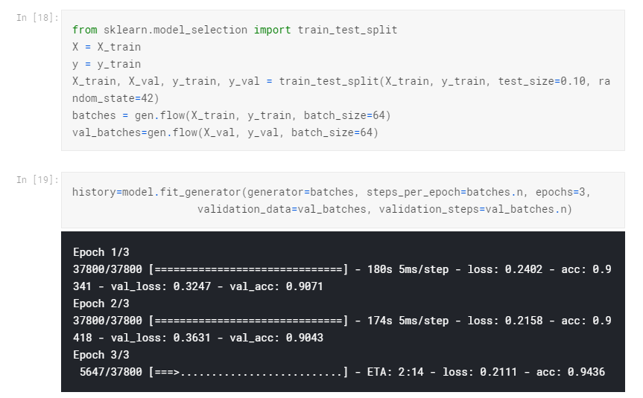
Validation

Slide 27
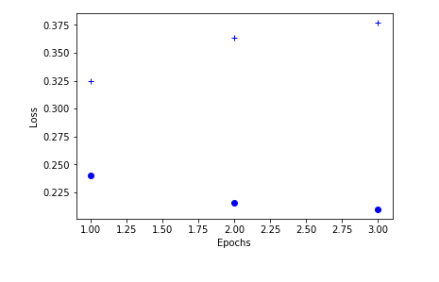
Epoch Vs Loss

Slide 28
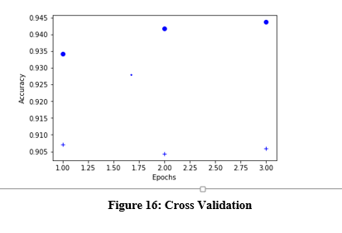
Epoch vs Accuracy

Slide 29
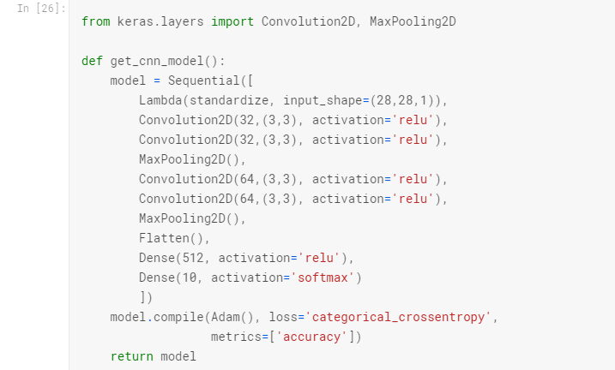
CNN

Slide 30
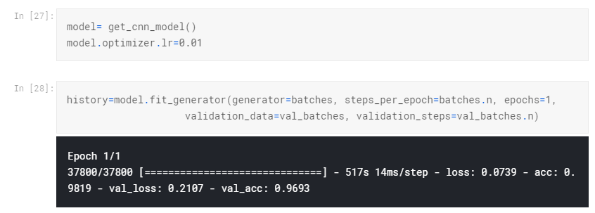
CNN

Slide 31
Batch Normalization
BN helps to fine tune hyper parameters more better and train really deep neural networks.

Slide 32
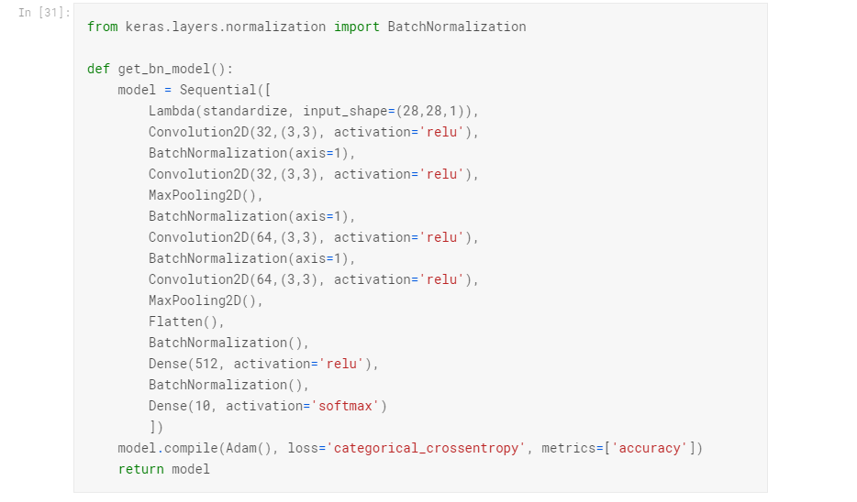
BN

Slide 33
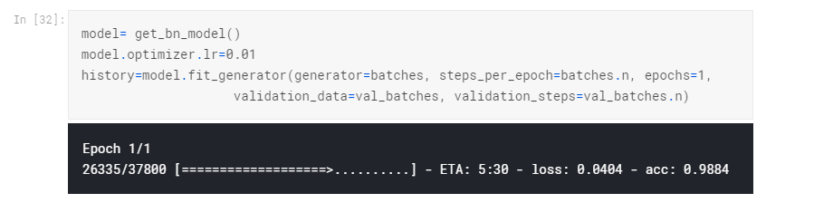
More Accuracy

Slide 34
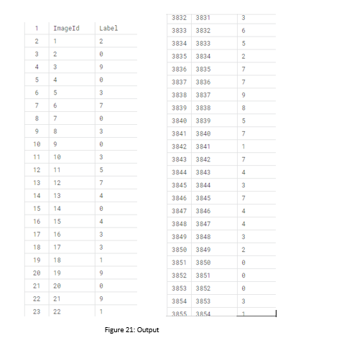
OUTPUT

Slide 35
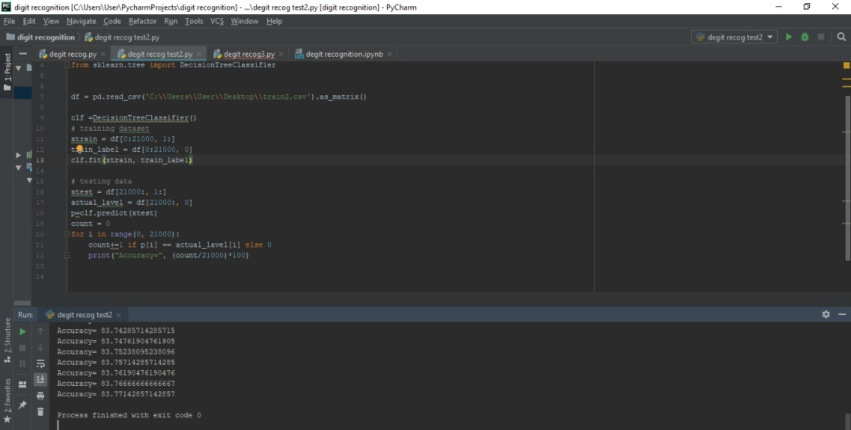
Decision Tree

Slide 36
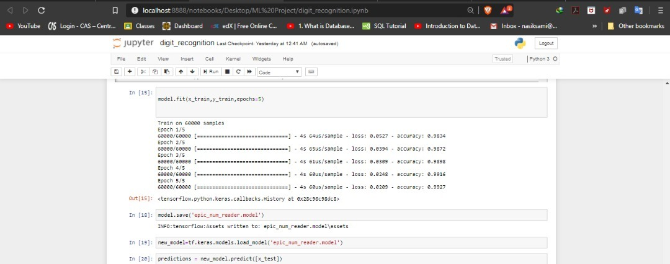
Neural network

Slide 37
Difference
Difference:
Algorithm | Accuracy | Accuracy | Accuracy
CNN | 0.9628 | 0.9693 | 0.9884
Decision tree | 0.8373 | 0.8375 | 0.8377
Neural network | 0.9298 | 0.97 | 0.98

Slide 38
Thanks For Hearing us

